Slide 1

Prof. Darrell Long
CSE13
Command Line Debugging

Slide 2
Definitions
A bug is an error or flaw with a program that produces an unexpected or incorrect output.
Debugging is the process of identifying and fixing these errors.
The reality is that there will always be errors that we find by testing and eliminate by debugging.
– The Practice of Programming, by Kernighan and Pike

Slide 3
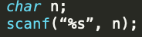
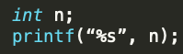
Easy Bugs
Minor errors that often occur during typing.
Out of bound memory access for read-ins using scanf().
Mismatched type conversions in printf() and scanf().
Fixing these bugs:
Examine the most recent changes made to the code.
Fix all occurrences of a bug.
Tackle crashes immediately.
Stack traces help debug misspelled variable name errors.

Slide 4
Hard Bugs
When you have no clue about the location of the bug.
Fixing these bugs:
Play around with inputs/parameters to code until bug is reproducible.
Write your own test conditions to check the code.
Write to a log file to check events that lead up to a crash.
Plot statistics of your code.
Keep records of all tests and results for bugs that take a long time to fix.

Slide 5
Debugging through Printing
The simplest form of debugging.
Simply print variable values and/or statements:
When you reach a certain point in the program.
Break program into chunks.
Can easily get out of control and difficult to follow:
For lengthier code.

Slide 6
Debugging Tools
assert(), gdb, lldb, valgrind, infer, gprof and scan-build

Slide 7
assert()
A macro used to check a given condition during runtime.
If the condition evaluates to false then the program exits.
To use it include the header assert.h.
This method is more sophisticated than simply printing values.
It is easily turned on and off at compile time.
As opposed to using flags and if statements.

Slide 8
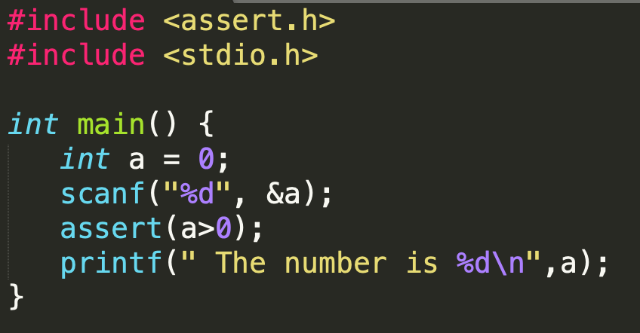
Using assert()
Call the assert() macro.
The input parameter is any C expression:
Usually a conditional.
If the expression evaluates to true, then it does nothing.
If it evaluates to false, an error is printed to stderr.

Slide 9
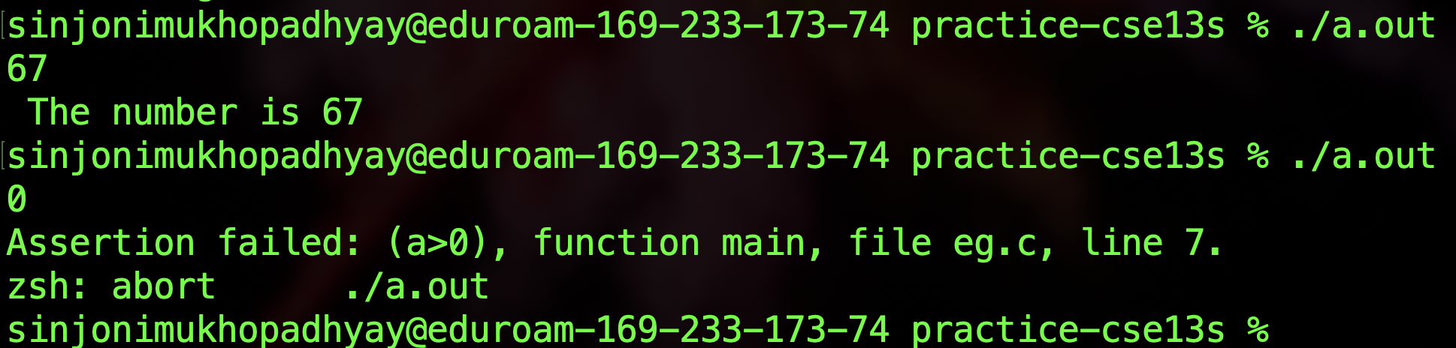
Using assert()
When the condition evaluates to false you will see an error like the one shown below.
Assertions can be disabled in two ways.
Including the macro #define NDEBUG.
Passing the argument -DNDEBUG to your compiler.

Slide 10
gdb
A useful debugging tool:
Set breakpoints.
Step through a program line by line.
At each breakpoint and step:
Print values or addresses of variables.
You must compile your program with debugging symbols.
-g option with clang and GCC.
Does not provide much information about memory errors.

Slide 11
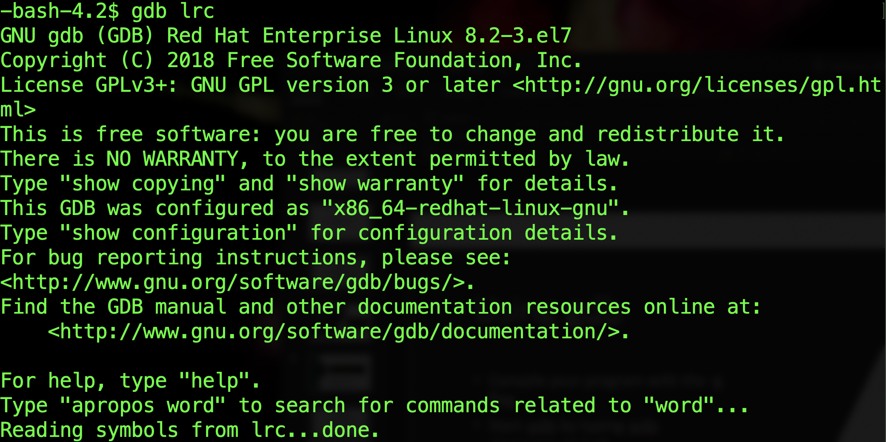
Using gdb
Compile your program with the -g flag.
Start gdb by typing gdb <executable>.
To run your program in gdb type run <arg1, arg2, ...>.
No arguments used in the lrc example.

Slide 12
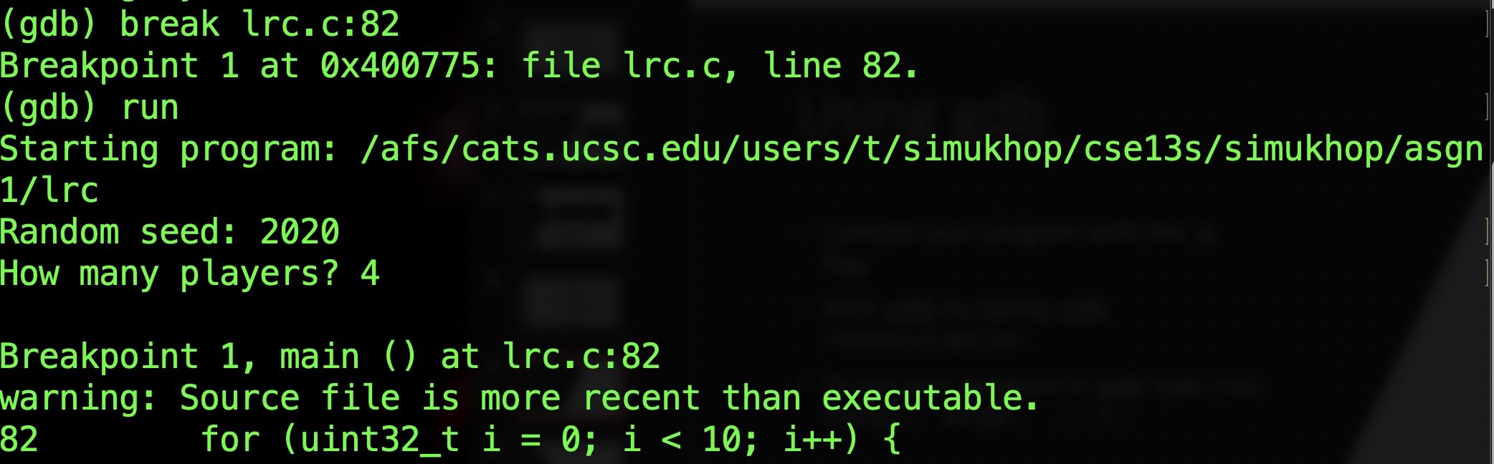
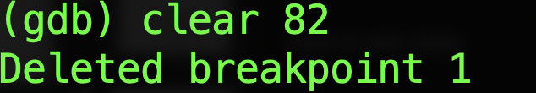
Using gdb
To set a breakpoint use the command break file.c:line_number
The example sets a breakpoint at line number 82 of file lrc.c.
You can also set a breakpoint at a function with break functions
Once your code has hit a breakpoint you can resume execution with continue
You can delete a breakpoint using the clear command.

Slide 13
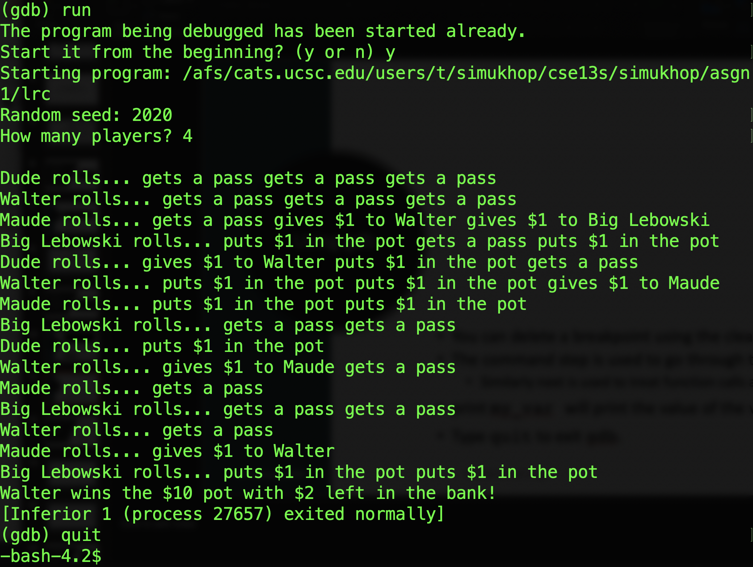
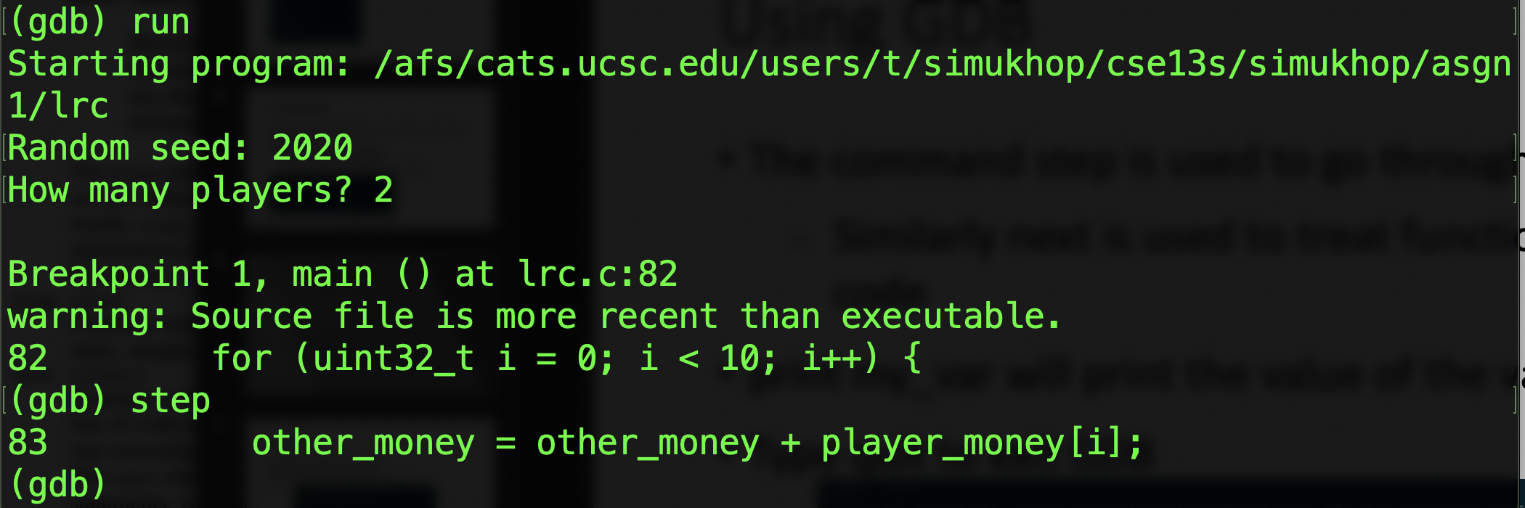
Using gdb
The command step is used to go through the program line by line.
Type quit to exit gdb.

Slide 14
Using gdb
Other commands include:
backtrace/bt: which prints out a segmentation fault stack trace.
where: prints a stack trace of the current point in the program.
finish: finishes execution of a function.
delete: like clear removes a breakpoint
Additional documentation can be found here, https://www.gnu.org/software/gdb/documentation/

Slide 15
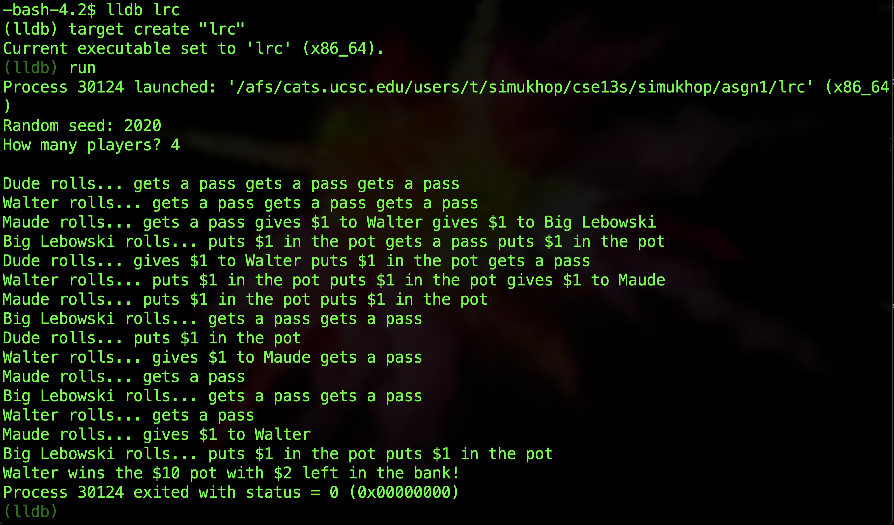
lldb versus gdb
lldb is very similar to gdb in its command structure.
More structured than gdb.
Commands to start process: process launch, run , r.
Breakpoints are created using:

Slide 16
infer
Similar to Valgrind and will pick up what the previous tool does not.
This is not installed on the university timeshare, you will have to run it on your local machine.
To install infer follow this guide https://fbinfer.com/docs/getting-started.html

Slide 17
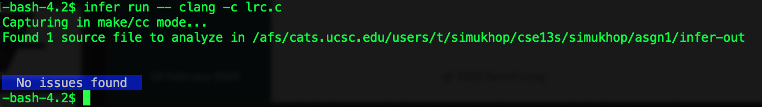
Using infer
To run infer on a relatively simple program type infer run –- clang -c lrc.c
If your program has no problem you should see the following.

Slide 18
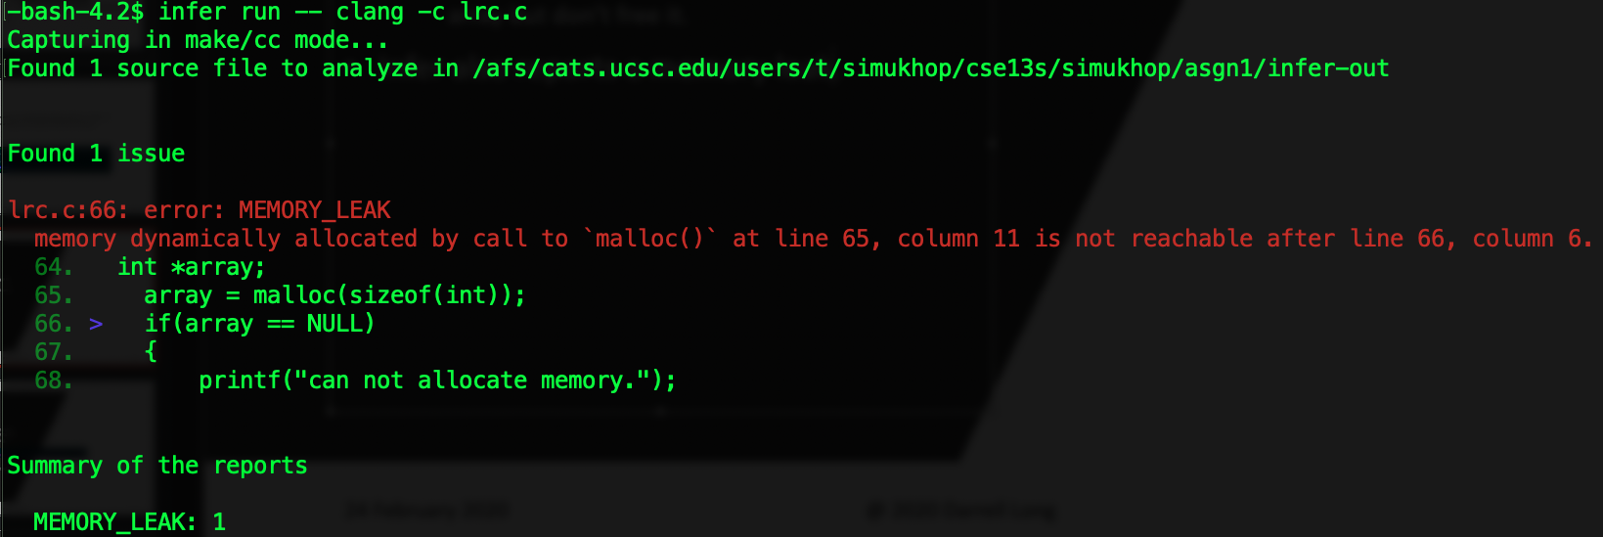
Using infer
In the case of our previous changes to lrc.c :
Where we modify our program to allocate an array but don’t free it.
Infer also reports a memory leak.

Slide 19
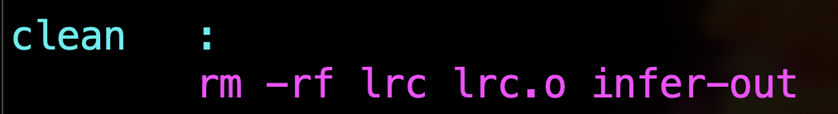
Using infer
For more complicated programs you should create a Makefile target to run infer that looks like the following.
Be sure that your clean target removes the extra files generated by infer.

Slide 20
valgrind
Analysis tool used to identify memory management problems.
Will tell you the location and size of memory leaks, deallocation errors, etc.
No additional compilation flags needed.

Slide 21
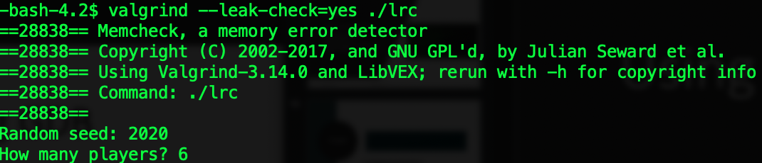
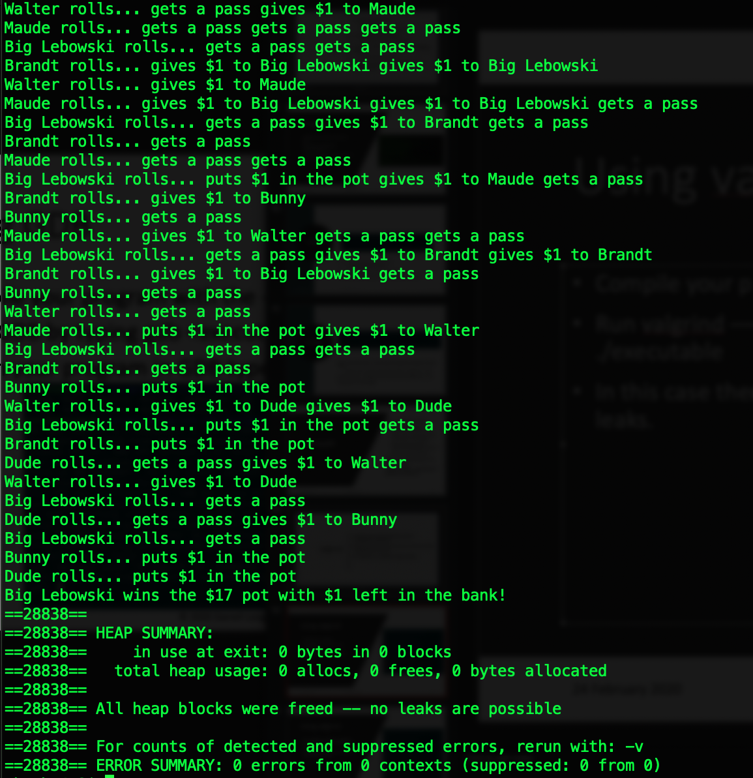
Using valgrind
Compile your program.
Run valgrind ––leak-check=yes ./executable
In this case there are no memory leaks.

Slide 22
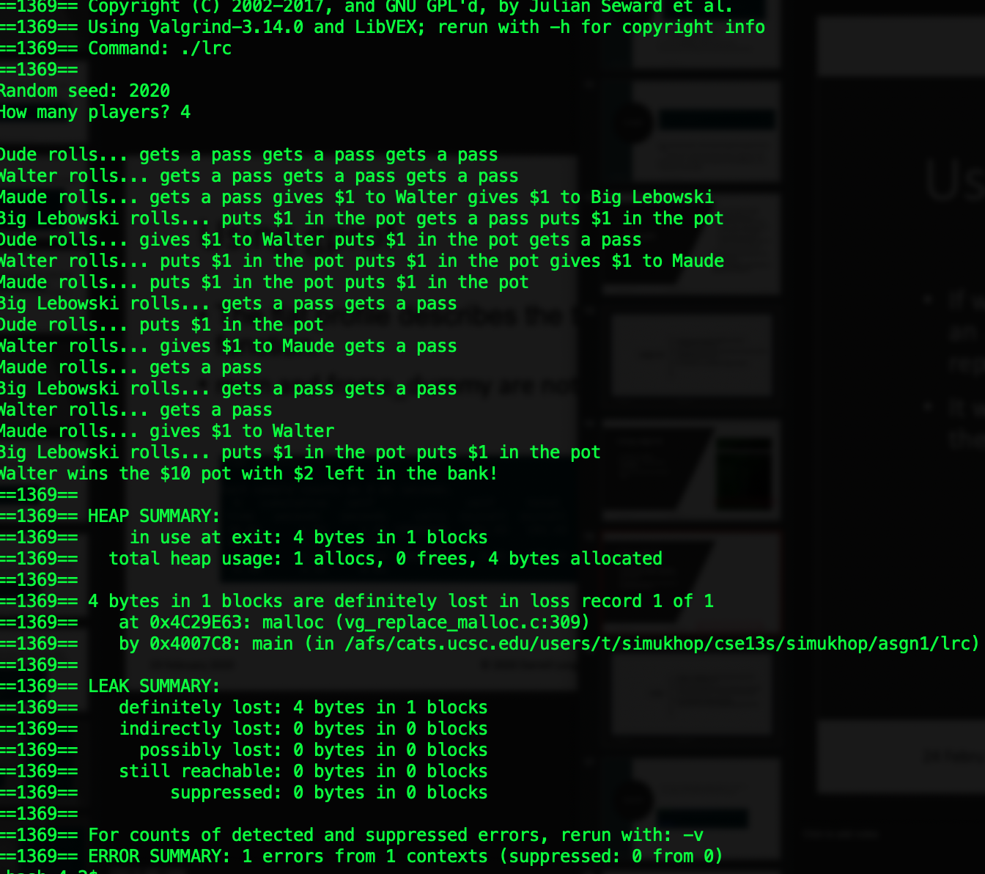
Using valgrind
If we modify our program to allocate an array but don’t free it,
valgrind will report a leak.
It will give you the line, file, and size of the unfreed allocation.

Slide 23
gprof
Gathers timing information and statistics about your program.
Use it to profile performance and identify bottlenecks.
Compile your program with the -pg option.
This creates a file called gmon.out.
Like the Valgrind and Callgrind tools.
A handy guide can be found here: https://users.cs.duke.edu/~ola/courses/programming/gprof.html

Slide 24
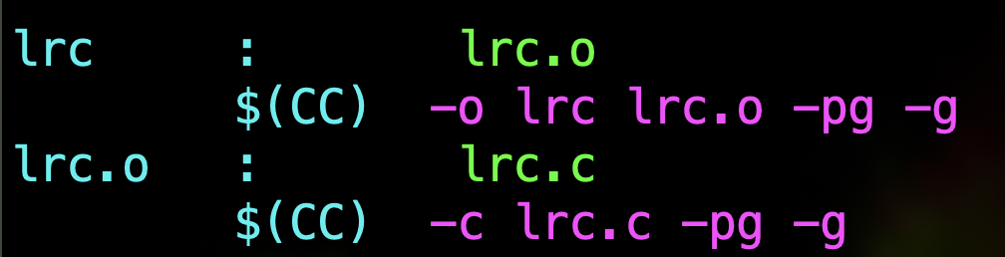
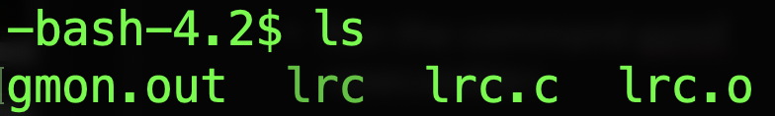
Using gprof
Compile your program with the -pg flag.
Run your program normally.
Run the command gprof <executable>.
Interpret the output.

Slide 25
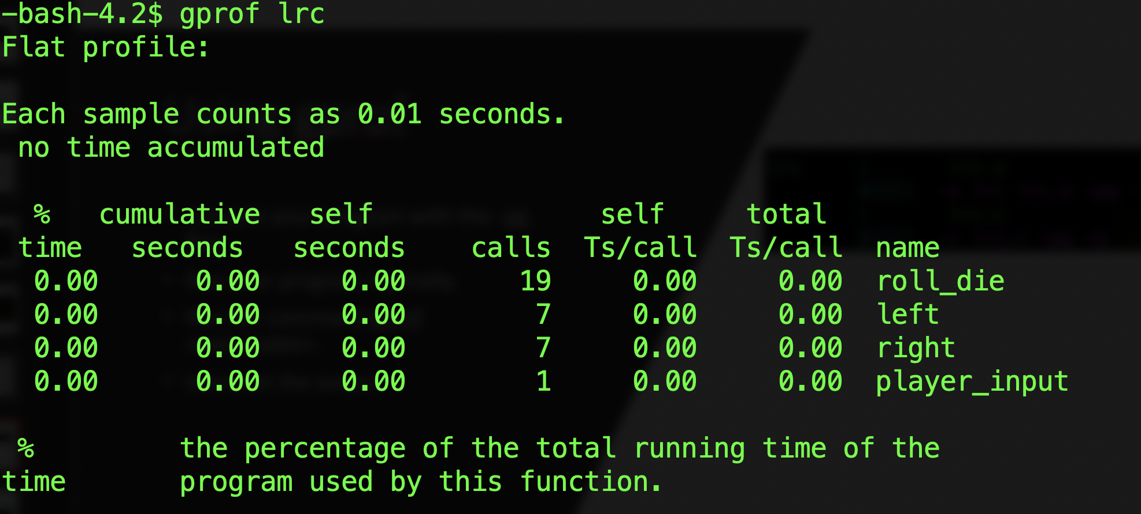
Using gprof
The flat profile describes the timing information for each profiled function.
4 functions have been profiled for lrc.c .

Slide 26
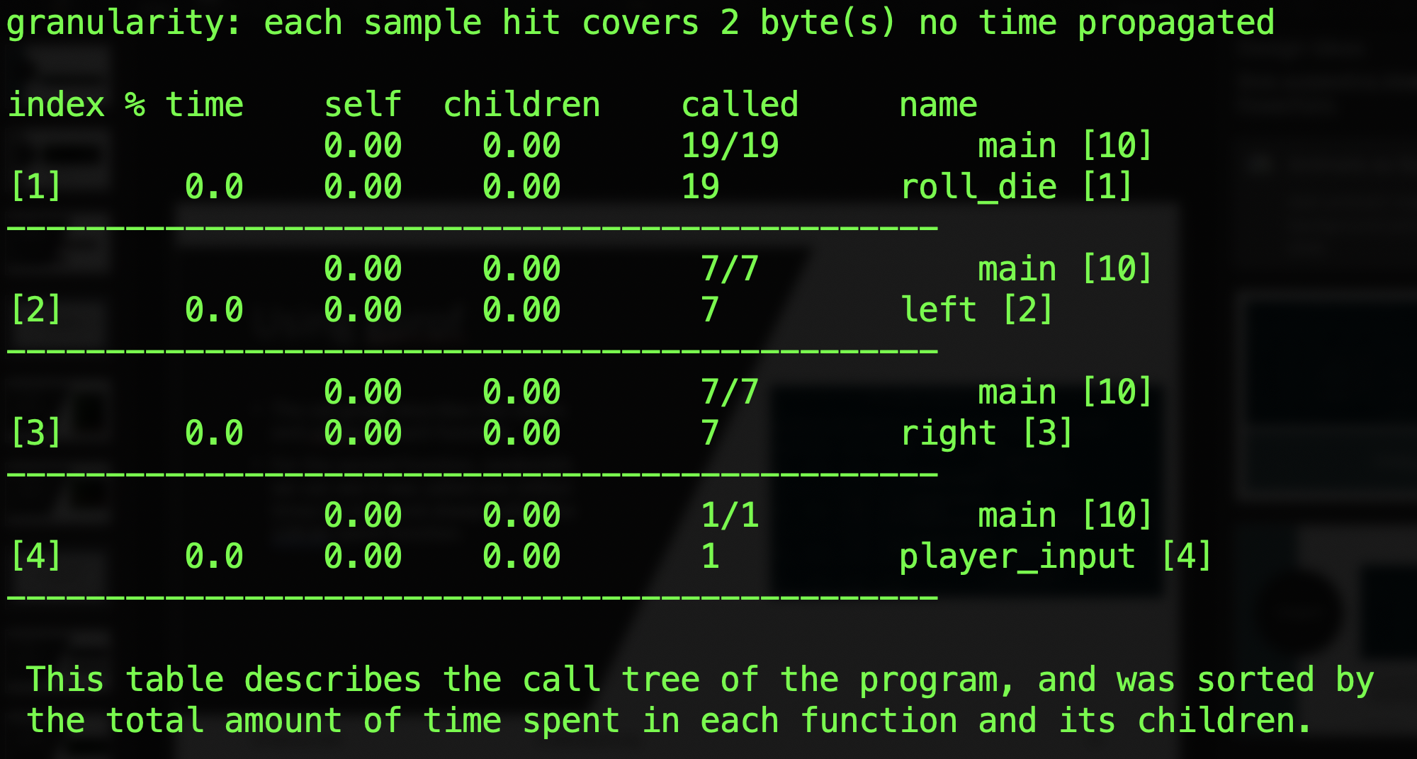
Using gprof
The call graph describes the callers and callees of each function.
For the first function, roll_die, we can see it was called 19 times by the main function.

Slide 27
scan-build
Static analyzers find bugs during run time.
Analyzes the source files compiled during build.
Can be used with gcc, make, clang etc.

Slide 28
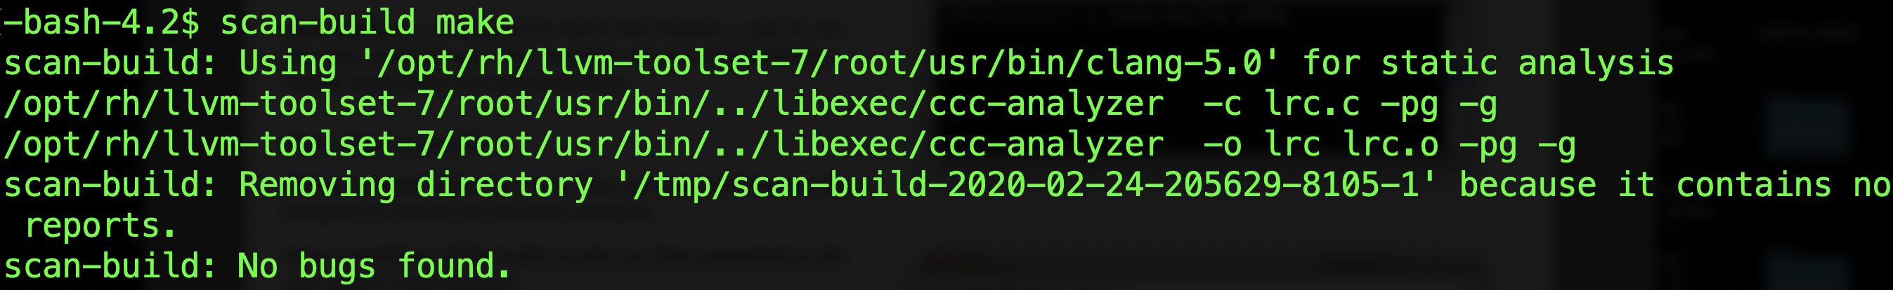
scan-build make without bugs

Slide 29
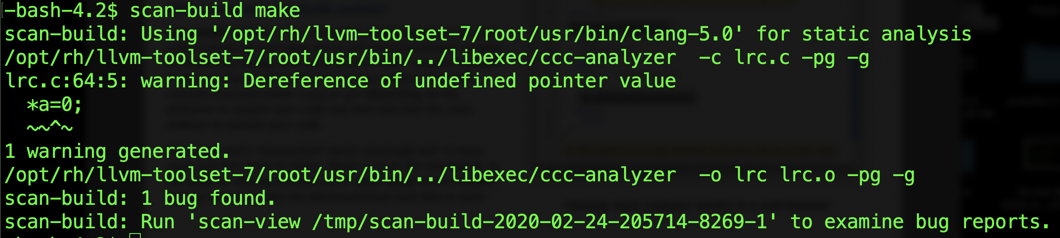
scan-build make with bugs

Slide 30
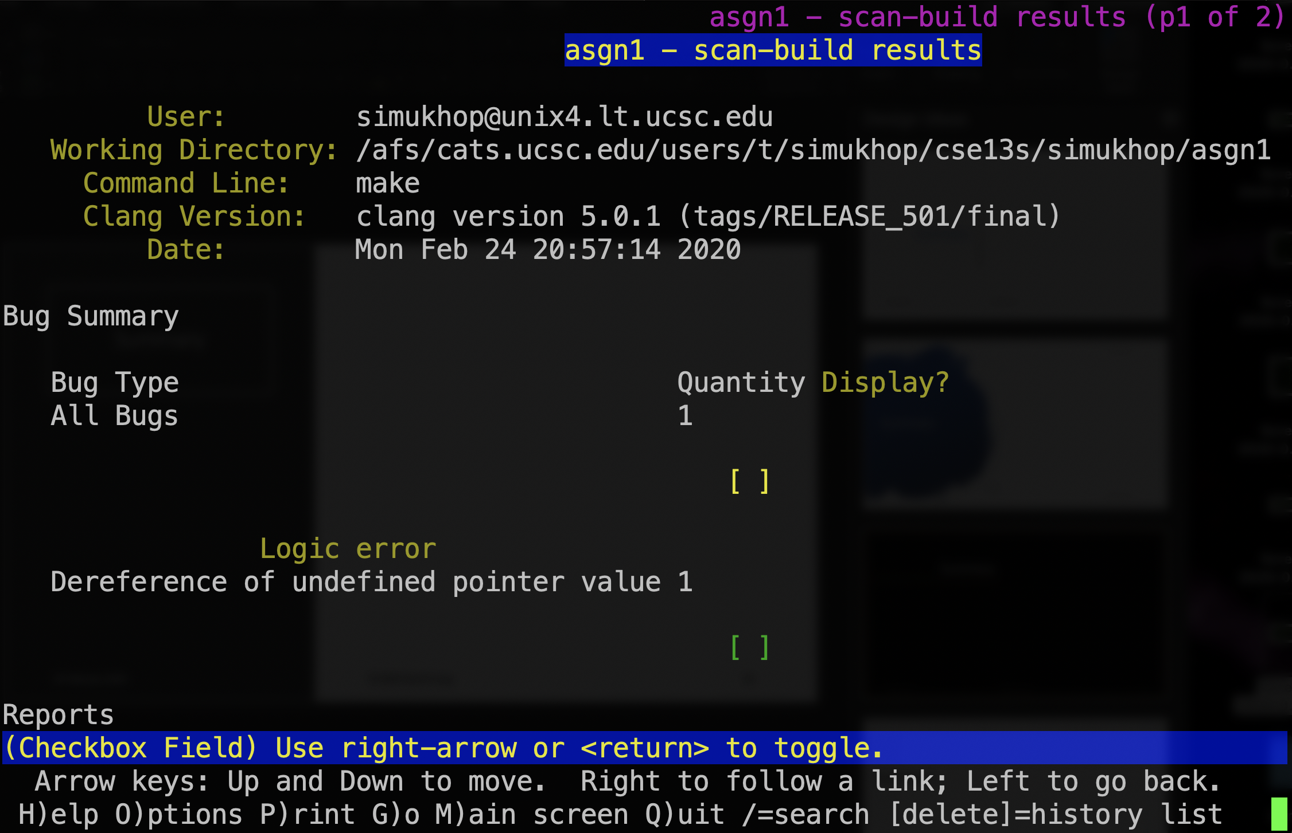
Bug report

Slide 31
Summary
Debugging and testing are a major part of the coding process.
Using debugging tools are easier than using print statements for longer programs.
Gprof and valgrind are debugging tools that test memory management of code.
gdb and lldb are the most used debugging tools for C programs.
Static analyzers like scan-build can be used with make, clang etc.

